Slide 1
Barents Cooperation
in Science and Higher Education
Alexey Ivanov
Ministry of Foreign Affairs of the Russian Federation Head of Unit for Regional Cooperation

Slide 2
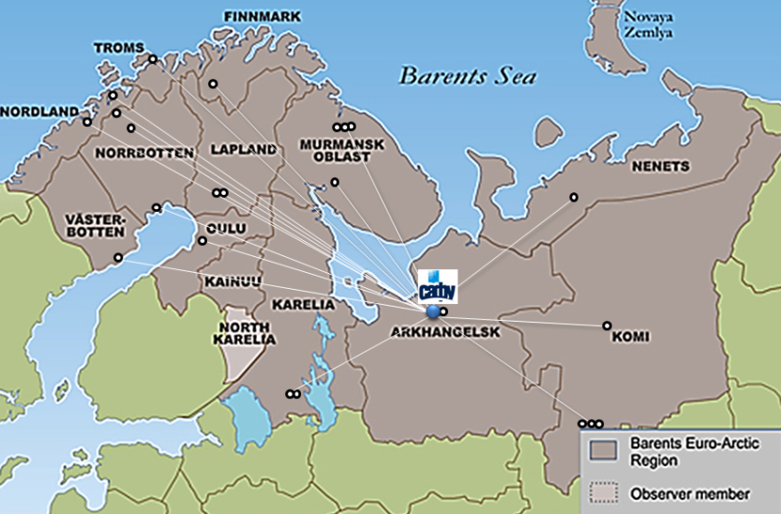
Joint Working Group on Education
and Research
Mission: strengthening academic cooperation in the Barents Region and creating a regional educational space
Tool for regional policy development in the sphere of education and research
Providing expertise for regional development through advanced research and educating high-skilled graduates
Networked-based activities of BEAR universities and research institutions
Established 1993
2011-2013: Co-chaired NArFU, University of Tromsø
2014-2015: Co-chaired NArFU, Lapland University
Mission: strengthening academic cooperation in the Barents Region

Slide 3
JWGER members
Northern (Arctic) Federal University, Arkhangelsk, Russia (Chair)
Lapland University, Rovaniemi, Finland (Co-Chair)
Nord University, Bodø, Norway
University of Tromsø - the Arctic University of Norway
Kajaani University of Applied Sciences, Kajaani, Finland
Murmansk State Technical University, Russia
Northern State Medical University, Arkhangelsk, Russia
Ukhta State Technical University, Russia
Syktyvkar Forest Institute, Komi Republic, Russia
International Institute of Business Education (MIBO), Murmansk region, Russia
Kola Science Center of Russian Academy of Sciences, Apatity, Murmansk region, Russia
Petrozavodsk State University, Petrozavodsk, Russia
The Komi Republican Academy of State Service and Administration, Russia
Syktyvkar State University

Slide 4
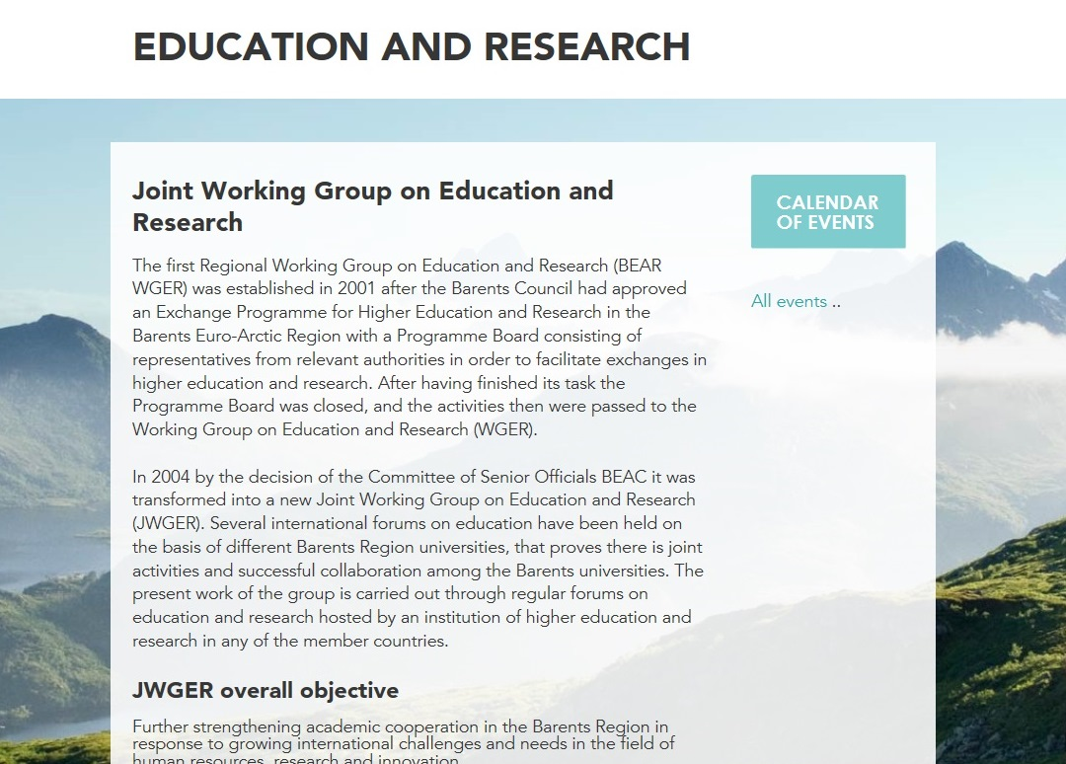
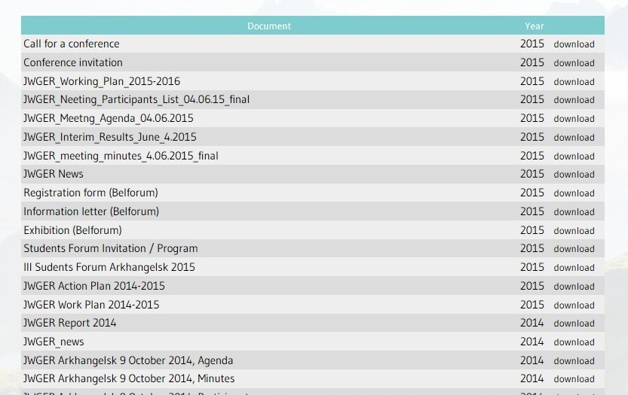
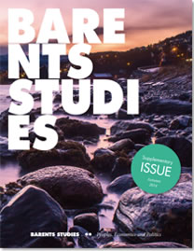
JWGER Web-page
http://www.beac.st/en/Working-Groups/Joint-Working-Groups/Education-and-Research

Slide 5
JWGER Mandate (adopted 2009)
Promote education and research as the tools for regional and economic development
Consolidate efforts for research-based education and interdisciplinary dialogue in fundamental and applied research
Enhance the quality of education and training in the region
Promote joint academic programs and training courses
Use e-learning as an effective instrument of academic interaction among the actors
Support academic mobility programs
Provide debating arenas (BEAR forums on education and research)
Support establishing and functioning educational consortia and networks
Encourage partnership with other actors of the Barents cooperation, incl. regional authorities, industries, NGOs
Share the experience and disseminate information about successful international projects in the field of education and research

Slide 6
JWGER Priorities
Action Plan 2013-2015
Priority 1: Strengthening the JWGER membership and streamlining the strategy in response to new challenges and needs
Priority 2: Contributing to implementation of regional strategies (climate change, transportation)
Priority 3: Interacting and cooperation with other BEAC WGs
Priority 4: Enhancing academic cooperation and mobility in the Barents Region
Priority 5: Mapping out synergy with networks in the North (EU ND partnerships, UArctic, AC WGs and TFs)

Slide 7
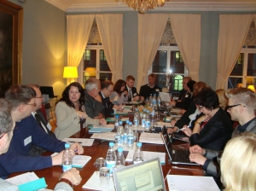
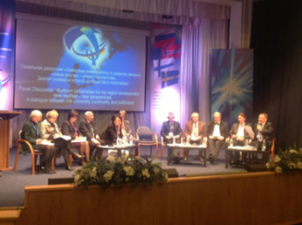
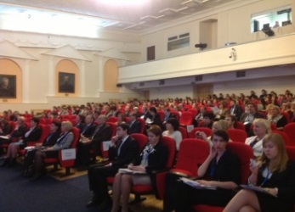
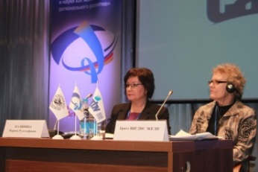
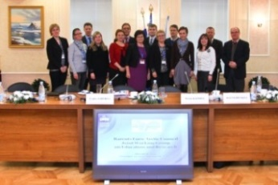
Enhance collaboration in E&R
Contribution to the Kirkenes Declaration 2.0:
Mobility of staff and students (PhD Barents School)
Recruiting to public and private sector
Transparency of national HE systems
Indigenous issues
The human dimension
Research and education infrastructure
Research and research-based education
Smart regions and smart specialization
Nov. 2012, NArFU: International Conference “Cooperation in BEAR in the Field of Education and Research as a Resource of Regional Development”
Oct. 2012, St. Petersburg / Nov. 2013, Brussels: Workshops: “Barents Research and Innovation: Priorities within Horizon 2020”
2009-2014: Joint projects within Kolarctic ENPI CBC Programme 2009-2014

Slide 8
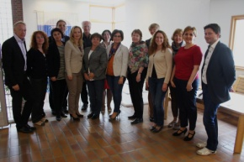
Develop communication in E&R
JWGER meetings:
Nov 29, 2012 – NArFU, Arkhangelsk
Nov. 19, 2013 – Brussels, Belgium
Oct. 9, 2014 – NArFU, Arkhangelsk
June 4, 2015 – Nord University, Bodø, Norway
April 7, 2016, Arkhangelsk
JWGER project (April – August, 2015):
“Internationalization of Higher Education as a Resource of the Barents Region Development” (UiN – NArFU)
priority areas in education and research;
enhancing internationalization of HEIs;
international conference “Internationalizing Higher Education: Barents Region and Beyond”
JWGER project (Summer 2016: 2 workshops)
BEAC Communication Development Project
Partners: IBS, NArFU, Syktyvkar SU, Lapland University, Kainuu Regional Council
JWGER contribution
Finnish Chairmanship Communique on BEAC Chairmanship Results (2013-2015)
RF Chairmanship Programme 2015-2017

Slide 9
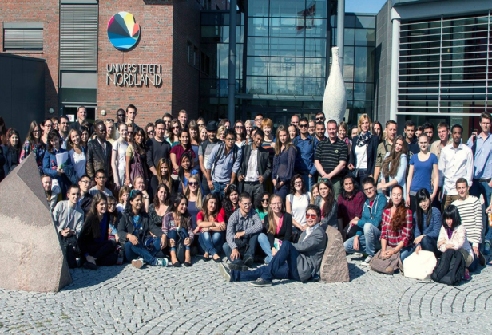
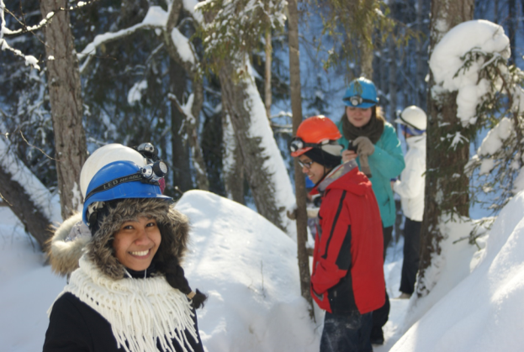
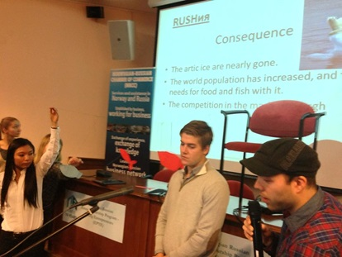
Prioritize academic collaboration
HEIs internationalization and creating a regional educational space
Students and staff exchanges:
the Barents PhD School (UiT, Umeå, Oulu, NArFU)
Umeå University (Abisko, Sweden) (Aug., 2015)
Joint educational programs (tourism, environmental risks, ICT in medicine, health care, circumpolar studies, social work, inclusive education)
Participation of Barents HEIs in Intergovernmental Working Groups on Education (Russian-Norwegian, Russian-Finnish)
Cooperation with business and industries (NRCC – Young Entrepreneurs Project)

Slide 10
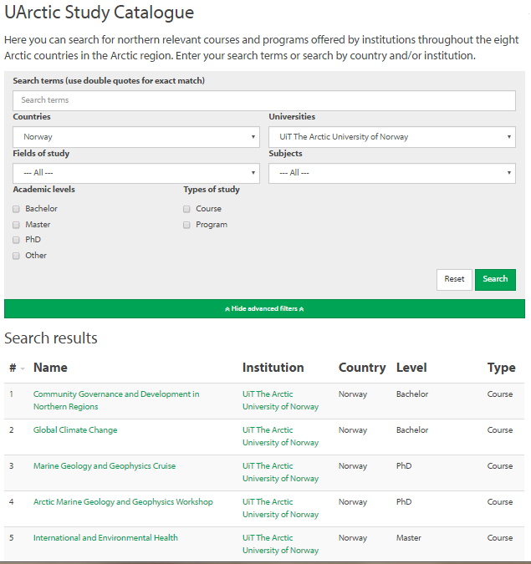
Study Catalogue
http://education.uarctic.org/studies/
Study opportunities:
search by country/ university/ disciplines/
Type of study/ academic level

Slide 11
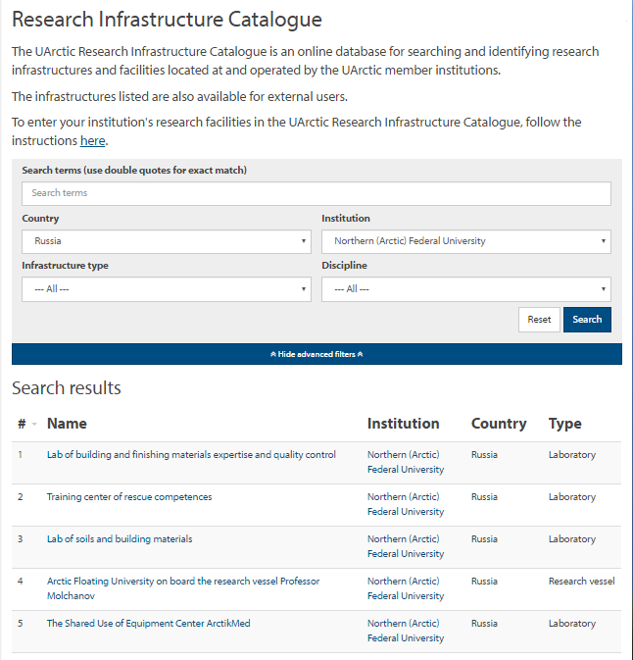
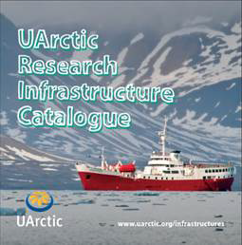
Research Infrastructure Catalogue
http://research.uarctic.org/resources/ research-infrastructure-catalogue/
Search for infrastructures: by country/ institution/ type/ disciplines

Slide 12
Barents HEIs in Arctic Research
 | Thematic networks |  | Thematic networks
1 | Environmental Training and Education for Sustainable Development of the Arctic (NETESDA) | 23 | Northern Nursing Education
2 | Energy in New Time | 24 | UArctic World Ensemble
3 | Environmental Impact Assessment of Industry Contaminated Areas | 25 | Arctic Fisheries and Aquaculture
4 | Arctic Sustainable Arts and Design | 26 | Arctic Engineering
5 | Natural Hazards | 27 | Communicating Arctic Research
6 | Working in the Arctic | 28 | Commercialization of Science and Technology for the North
7 | Arctic Law | 29 | Digital Media and Media Arts
8 | Geopolitics and Security | 30 | Northern Food Security
9 | Local and Regional Development in the North
10 | Managing Small and Medium Sized Enterprises in the North
11 | Northern Tourism
12 | Arctic Extractive Industries
13 | Arctic Geology
14 | Northern Governance
15 | Health and Well-being in the Arctic
16 | The Verdde Program
17 | Model Arctic Council
18 | Teacher Education for Social Justice and Diversity in Education
19 | Polar ice, climate and land dynamics
20 | Social Work
21 | Arctic Telecommunications and Networking
22 | Distance Education and e-Learning

Slide 13
Contribution to Action Plan on Climate Change
Barents HEIs Expertise Related to Climate Change
Development of cutting-edge knowledge and multidisciplinary research on:
Environmental impact assessment, analysis of northern ecosystem dynamics;
Causes and effects of changes in climate and environment;
Biodiversity in sub-arctic ecosystems under conditions of climate change;
Conventional and renewable energy production, black-carbon emissions;
Permafrost studies;
Impact of environmental and climatic factors on human body functions;
Indigenous peoples’ competence, the challenges indigenous peoples face due to climate change, and how traditional knowledge can contribute to development;
Adaptation to changing environmental, economic, social and cultural circumstances in order to promote a sustainable future;
Scientific basis for sustainable management of ecosystems;
Arctic marine system ecology;
Emergency prevention and response;
Space monitoring and remote sensing

Slide 14
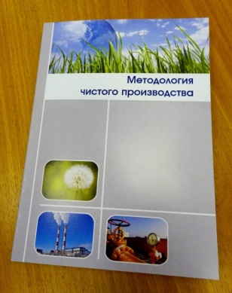
Inter-acting with BEAC WGs
JWGER – WGE / CPESC project (funded by Swedish Environmental Agency)
Objective: Introduce clean production methodology and UN standards to be included into education
Coordinators: Moscow Center for Clean Production, NArFU
Participants: NArFU, Murmansk State Technical University, Syktyvkar Forestry Institute
2013-2014: workshops Arkhangelsk, Syktyvkar, Murmansk
2014: new educational courses on CPESC (e.g. NArFU: “Ecology and Land Use”, “Heat Power Engineering and Heat Technology”)
2014-2015: publication “Methodology of clean production” (NArFU, MSTU, SFI, Karelian Chamber of Commerce)
2015: Presentation of the project outcomes at WGE meeting, Arkhangelsk)
2016: next stage planning (International Workshop Development RIO 2020/ CPESC in specific sectors)

Slide 15
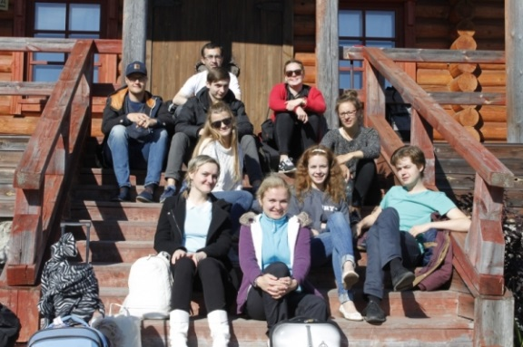
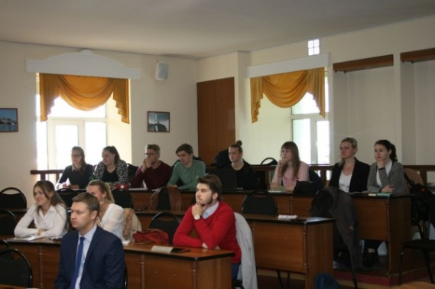
Inter-acting with BEAC WGs
JWGER – JWGY project (funded by the RF Ministry of Education and Research/Youth Federal Agency “ROSMOLODYEZH”, Norwegian Barents Secretariat / BRYC)
Project “Russian North – the Solovetsky Islands”
Dates: Aug. 28 – Sept. 2, 2015, Arkhangelsk
Objective: promote youth cooperation in the Barents Region; study culture and history of the Russian North
Participants: members of BRYC
Activities and results:
study trip to Solovetsky Islands
workshop “Russian North – Solovetsky Islands”
round-table “Best Practices of Barents Youth Governance”
visits to the Youth House of Arkhangelsk Region
participating in the ceremony of the academic year launch

Slide 16
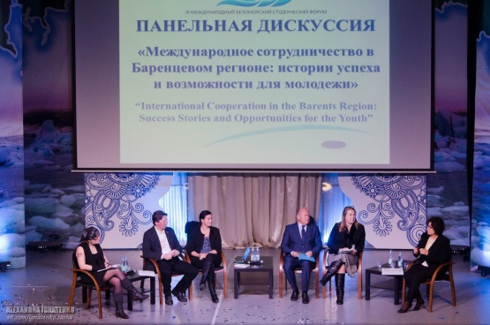
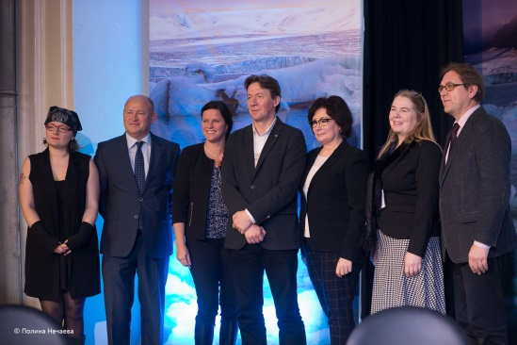
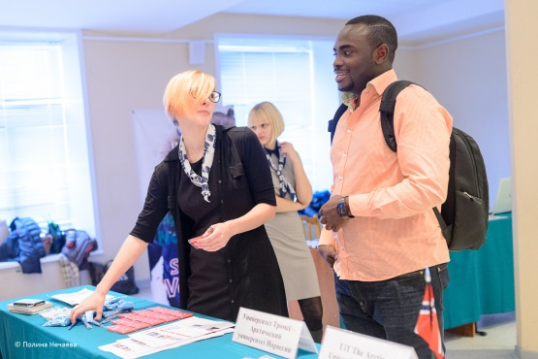
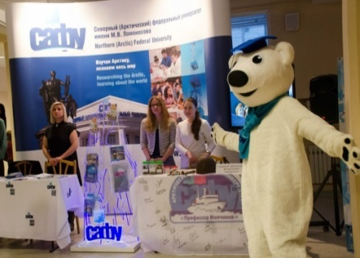
Project “The 3rd International Belomorsky Students Forum” / Barents Bird Festival
Panel Discussion International Cooperation in the Barents Region: Stories of Success and Opportunities for Youth (over 300 participants from 6 countries and 14 Russian cities of the BEAR)
International Education Exhibition Barents EDU: promotion of Barents universities as study destination
Open lectures for students
International workshops: How to participate in exchange programs within the Barents region
Students projects presentation: My Model of International Cooperation
The idea: support youth cooperation, promote the Barents Region as a successful model of cross-border cooperation and attractive destination for studies and life, inform about RF BEAC Chairmanship priorities

Slide 17
Tasks 2016 – 2017
Strengthening membership / Rotation of chairmanship
Contributing to Barents Transportation Plan implementation
Draft of the Action Plan on Research and Education
Promotion of Barents Region as an attractive study destination
Arctic Studies Summer School
Joint applications to Kolarctic CBC Programme 2016-2020

Slide 18
Prospects and challenges
Research cooperation in the BEAR will benefit from scientific cooperation agreement in the Arctic (AC SCTF)
Academic cooperation in the BEAR: support for mobility (undergraduate, graduate, research, internships, indigenous students)
Regional development: what kind of expertise Barents universities can provide and what kind of resources are needed?

Slide 19
Thank you for your attention
Contacts Ministry of Foreign Affairs of the Russian Federation Second European Department Sergey Petrovich Deputy Director, Chairman of the Committee of Senior Officials of the BEAC (spetrovich@mid.ru) Phone +7 499 244 2697 Fax + 7 499 244 1797 Alexey Ivanov Head of Unit for Regional Cooperation (aivanov@mid.ru) Phone +7 499 244 1572 Fax + 7 499 244 1797 Inna Tarysheva First Secretary of Unit for Regional Cooperation (itarysheva@mid.ru) Phone +7 499 244 3096 Alisa Maslikhina Secretary-Referent of Unit for Regional Cooperation (aimaslikhina@mid.ru) Phone +7 499 244 3096 www.http://en.beac-russia.com/ Facebook: Russian Chairmanship of the BEAC Twitter: @Russia_in_BEAC

